Slide 1


OBAPAO, A DECISION-SUPPORT TOOL FOR BIODIVERSITY AND PROTECTED AREAS MANAGEMENT IN WEST AFRICA
Observatory for Biodiversity and Protected Areas in West Africa (OBAPAO): implementation of the TSCC in West Africa
Grand Popo, Benin, 21th January 2026

Slide 2

OBAPAO : FROM BIOPAMA TO THE CBD’S TSCC VIA THE CENTRE OF EXCELLENCE FOR BIODIVERSITY AND ECOSYSTEMS
CoE for B&F: 2024-2027
TSCC/WA CDB : 2025-2030
BIOPAMA : 2020-2025
consolidating and extending OBAPAO's areas of intervention
Setting up OBAPAO
Official establishment of OBAPAO
Biodiversity and Protected aeras
Biodiversity, protected/conserved areas and forests integrating socio-economic issues through support for the implementation of NaturAfrica and the Great Green Wall.
all themes relating to Biodiversity : the targets of the GBF KM

Slide 3
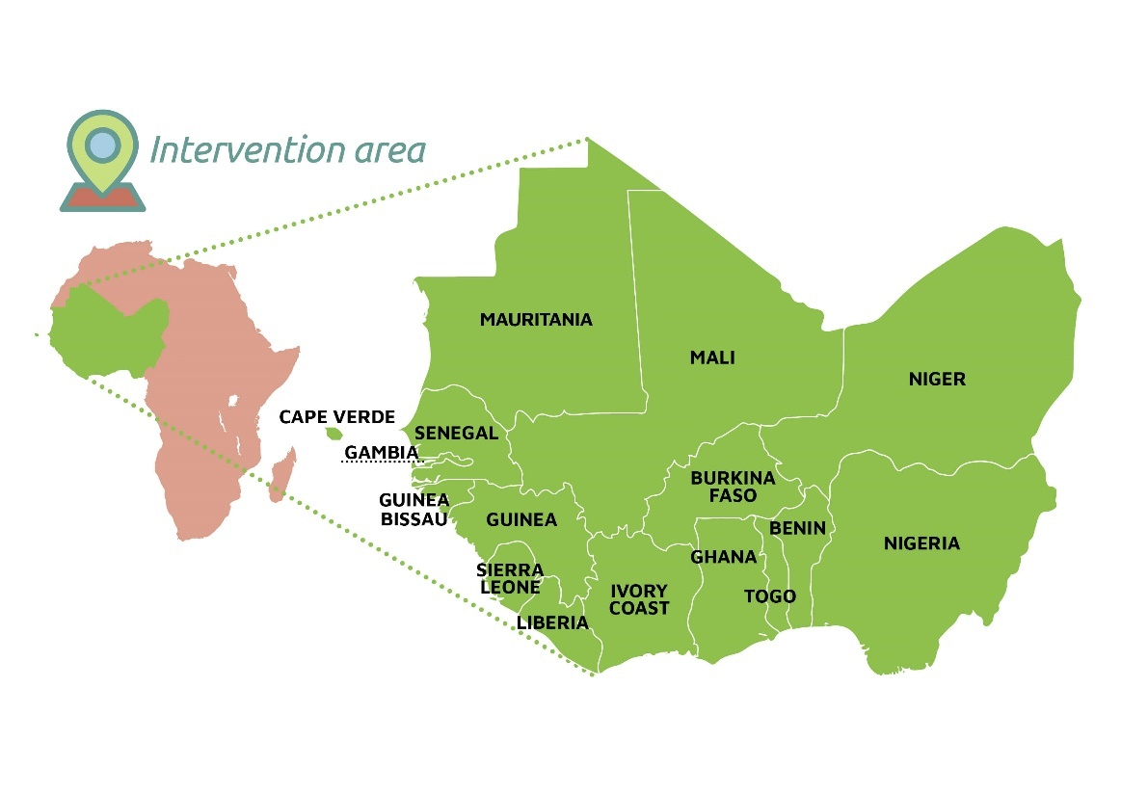











OBAPAO'S ORGANIZATIONAL STRUCTURE
OBAPAO'S STAKEHOLDERS
Technical Host: Consortium
Institutional Host : WAEMU
Member States
Centre de Suivi
Ecologique de Dakar (CSE)
Réseau régional d’Aires marines
protégées en Afrique de l’Ouest
(RAMPAO)
Regional marine center (RMC):
Université du Ghana (UoG):
Centre Régional Agrymet (CRA)
Donors and Partners

Slide 4
OBAPAO, TSCC/WA
CHALLENGES
❖ Availability of data and existing gaps:
A lack of centralized national data systems, which limits accessibility and interoperability;
Significant heterogeneity in data collection and management systems across institutions;
Limited access to scientific data and insufficient national data platforms;
Challenges in regularly updating data to feed biodiversity indicators.
❖ Identified needs in data, indicators, technical and scientifical assistance:
Assessment of countries' specific needs in terms of technical and scientific cooperation for the implementation of SPANB
Establishment of national biodiversity data centers or dedicated data management structures;
Harmonization of national and subregional indicators (aligned with regional policies) to ensure consistency with the GBF targets ;
Strengthening of human and institutional capacities for implementing GBF particularly for monitoring and evaluation (biodiversity indicators);
Capitalization and valorization of research data and expertise from species and taxonomic specialist groups;
Development of applied research programs and scientific exchange initiatives ;
Implementing Protocols.
The mobilization of financial resources and technical monitoring capacities is widely recognized as a critical need.

Slide 5
OBAPAO, TSCC/WA
West Africa TSCC: Status & Positioning
Where do we stand?
Official designation of CSE / OBAPAO as the West Africa Technical and Scientific Cooperation Support Centre (TSCC)
Agreement signed with the CBD Secretariat
Strategic support from the CEBio-Eco/WA Project (EU-funded)
Development of the support project / Program for the implementation of the NBSAPs (2026-2030).
Development of the biennial work plan is in progress (2025-2026)
Steering Committee is expected to be established T1 2026.
Positioning: a results-oriented regional hub for technical and scientific support
Start of country support through the activities of the CEBio-Eco/WA project :
Support for data collection and validation, including for the 7th National Report
Preparation of the subregional report on the implementation of the GBF in West Africa
Development of the subregional biodiversity knowledge management strategy
Capacity-building strategy under development, with an available budget

Slide 6
OBAPAO, TSCC/WA !
Project on the Implementation of NBSAPs in West Africa (2025-2030)
Goal: Build a subregional response to improve the planning, implementation, and monitoring-evaluation of NBSAPs and the GBF.
This subregional response should support implementation but, more importantly, enable the monitoring and evaluation of progress made in the context of the NBSAPs, both at the individual country level and collectively through a subregional stocktaking of the GBF.
Overall Objective: Implement a harmonized and aligned subregional support framework for the implementation, monitoring-evaluation, and reporting of NBSAPs and the GBF, through an operational mechanism for the production, dissemination, and management of high-quality data and knowledge on biodiversity and ecosystem services.
Development of the biennial work plan is in progress / Development of the support project for the implementation of the NBSAPs.

Slide 7
OBAPAO, TSCC/WA !
1. Thematic groups
The programme will strengthen or establish 15 working groups on the Kunming-Montreal Global Biodiversity Framework (GBF) priority themes for West African countries:
High Priority :
Target 20: Capacity-building, technology transfer and knowledge management, scientific and technical cooperation
Target 21: Access to data and information to support effective and equitable governance: Clearing-House Mechanism
Target 3 – 30x30: Mapping of potential areas to be designated as OECMs and biodiversity corridors; assessment of the management effectiveness of Protected and Conserved Areas (PCAs); the Green List of PCAs; mapping and updating of EBSAs
Target 1 – Spatial planning: Development of national and sub-regional Red Lists of ecosystems
Target 2 on ecosystem restoration
Target 19: Biodiversity financing
Target 4: Support for the development of national and sub-regional Red Lists of species
Target 7: Pollution
Target 8: Climate
Target 13: Fair and equitable sharing of benefits arising from the utilization of genetic resources
Target 17: Biosafety
Medium Priority
Target 6: Invasive Alien Species (IAS): Regional studies to develop a sub-regional strategy to combat IAS
Target 14: Natural Capital Ecosystem Accounting
Target 22: Public participation in decision-making
Target 23: Gender and biodiversity

Slide 8
OBAPAO, TSCC/WA !
2. Priority research and training themes
The priority research and training themes identified as part of the programme are listed below, without being exhaustive:
Red list of species and ecosystems
Green list of protected areas
Priority conservation areas (KBA, ZIEB and OEMC)
Invasive plants
Access and benefit sharing (ABS) of genetic resources and associated traditional knowledge
Biodiversity and climate change
Environmental crime
Biotechnologies and the use of data from the sequencing of genetic resources
Nature-based solutions ;
Combined carbon-biodiversity credits
Finance mecanisms

Slide 9
OBAPAO, TSCC/WA !
3. Portfolio of projects to be developed
As part of the mobilisation of funding for the implementation of the CMB KM, ideas for sub-regional projects have been put forward by country representatives. A non-exhaustive list of sub-regional projects is presented below:
Project to support the strengthening of scientific and technical cooperation for the implementation of the GBF in West Africa (targets 20 and 21)
Project to support the establishment of data infrastructure (Senegal, Gambia, Guinea, etc.) and the strengthening of national CHMs in West Africa (target 21)
Project to support the establishment of the IUCN red list of species and ecosystems (Targets 1 and 4)
Project to support the establishment and recognition of Other Effective Conservation Measures by Areas (OEMC) in West Africa (target 3)

Slide 10
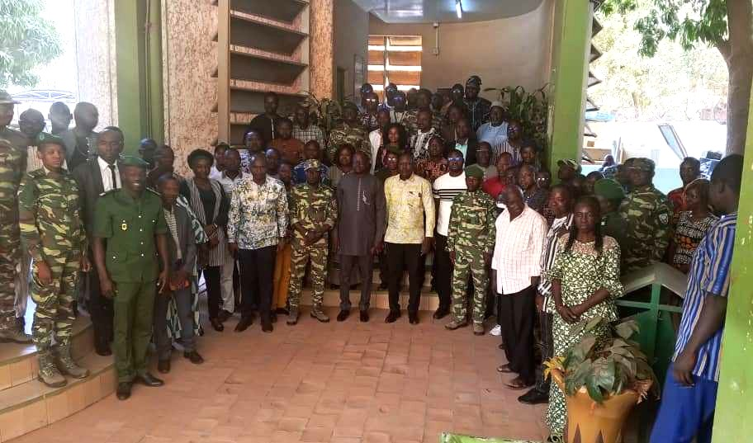
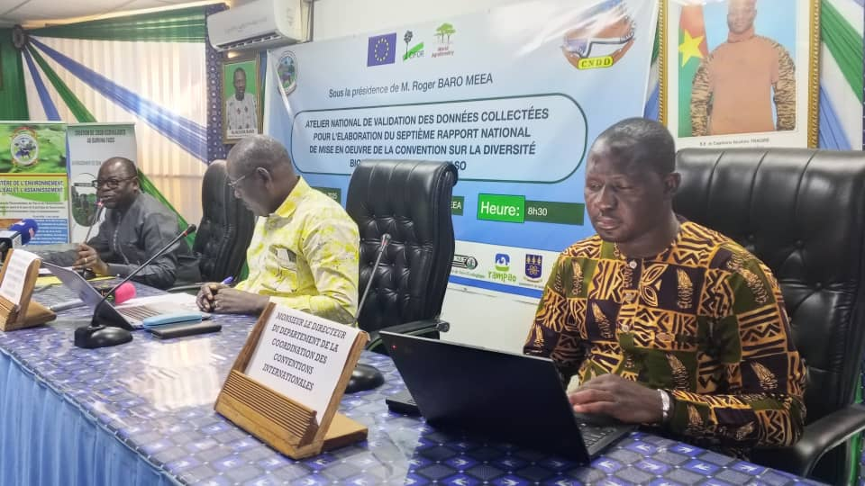
OBAPAO, TSCC/WA
Key Activities
1. Direct Support to Parties (Data & GBF Reporting)
Objective : support for Parties to effectively monitor and report on the implementation of the GBF
Financial transfers and technical support to countries (Senegal, Niger, Burkina Faso, Togo)
Data collection, harmonisation and national validation
Updating the WDPA / Protected Planet in collaboration with UNEP-WCMC Key success: rapid transition from planning to implementation

Slide 11
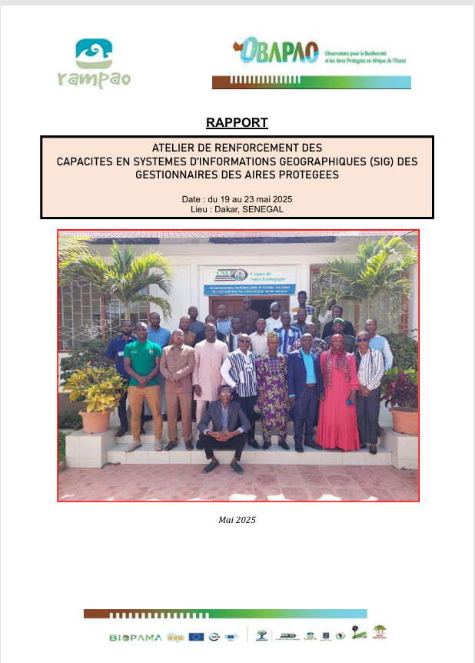
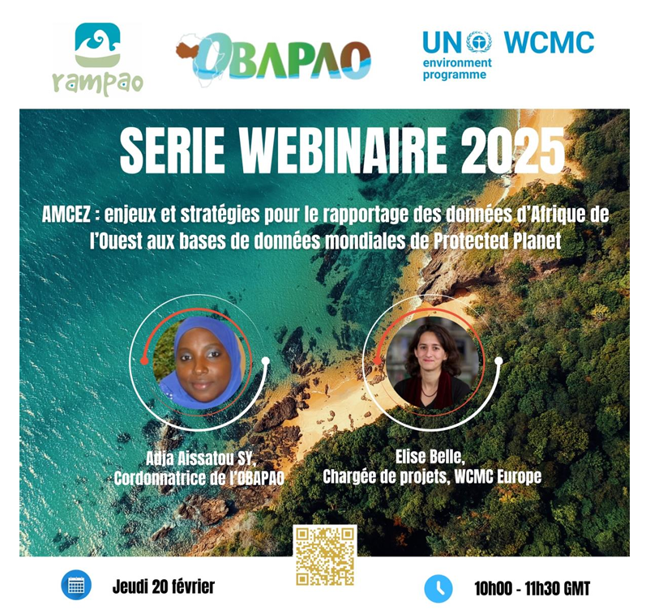
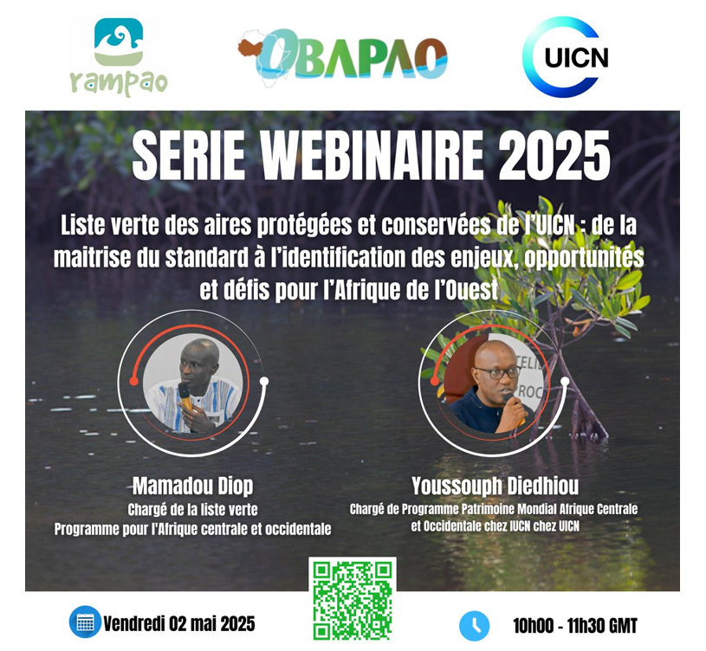
Activities TSCC/WA : 2024 - 2025
2. Capacity Building & Training
Régional Training: Data management standards workshop held in Guinea (Nov 2024)/ UNEP-WCMC.
Regional GIS Support: Specialized training in GIS and Remote Sensing for Benin, Burkina Faso, Ivory Coast, Niger, Senegal, and Togo.
Participation in regional workshop on the 7th National Report in Yaoundé (Sept 2025)/SE-CDB and Regional Training on Knowledge Management in Addis Ababa (July 2025) (Online) /SE-CDB
Webinaires : OECMs, Green List,
3. Strategic Partnerships and Technical Support
Collaboration currently under development with :
ESRI (GIS), HAC (Target 30x30) / T3-GIS WA Group (Nigeria): Licence acquisition, capacity building, and development of an integrated sub-regional hub within the RRIS.
IUCN Species Survival Commission and GBIF: Capacity building, development of species and ecosystem red lists, improving data reporting within GBIF, and enhancing the production of biodiversity information.

Slide 12
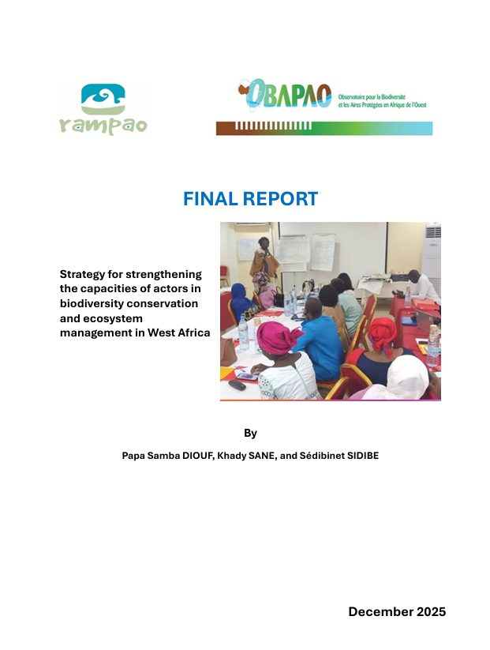
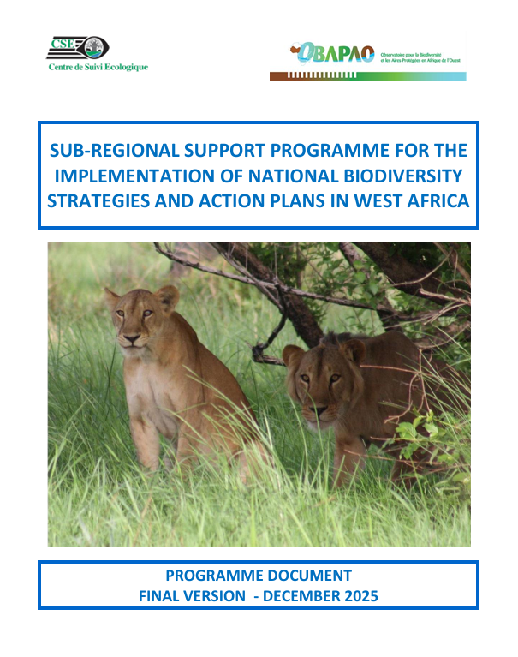
Activities TSCC/WA : 2024 - 2025
4. Documents in Development:
Sub-regional GBF implementation and alignment report.
1st Action Plan for the West African Protected and Conserved Areas (PCA) Strategy.
Sub-regional Knowledge Management Strategy
Ongoing report on the state of forests in West Africa (CIFOR)
5. Upcoming Milestones :
Q1 2026 (Jan–march): Sub-regional data validation workshop and Official Launch: Full operational kick-off with the establishment of the Steering Committee and T20 & T21 working groups.

Slide 13
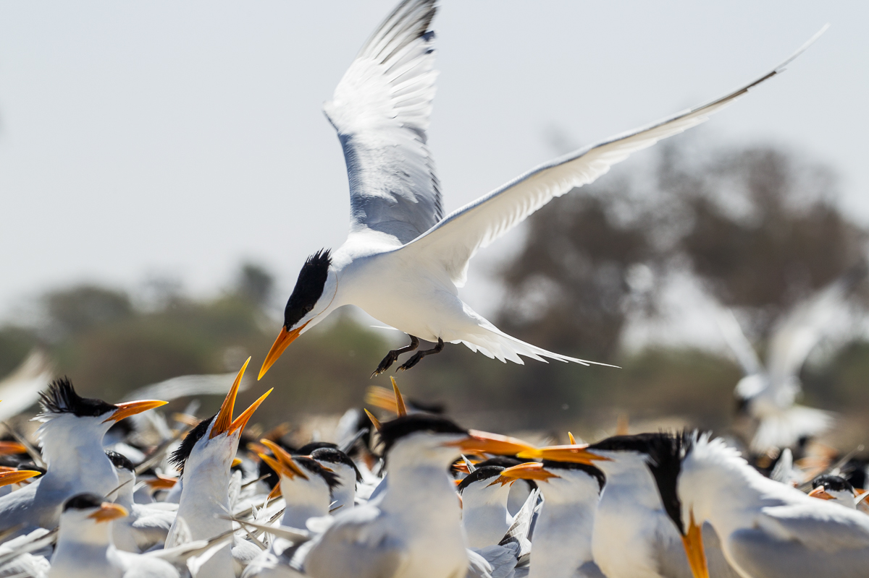
OBAPAO, TSCC/WA !
Main Operational Challenges
Mobilisation of additional financial resources
Limited human resources in view of strong regional demand
Uneven national technical capacities
High expectations from Parties for timely and practical support
West Africa specificity: high biodiversity pressure and urgent demand for results
Lessons learnt
Effective operationalisation requires pragmatism and national validation
Minimum harmonisation is essential; rigid uniformity is not
Key messages
The TSCC for West Africa was launched through the EU-funded CEBio-Eco project.
The challenges are well identified and shared, pragmatic solutions are available but financial resources are needed
The year 2026 is crucial for the operationalization of the TSCC (direct support to Parties – regional coordination – mobilisation of technical, scientific and financial resources), 2030 is now!

Slide 14

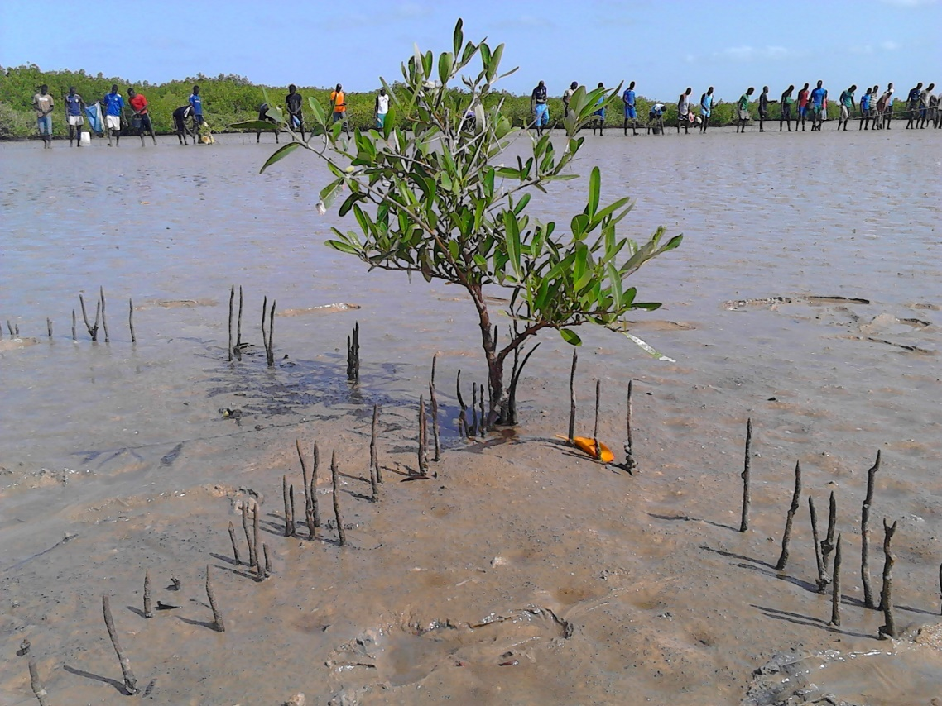
THANK YOU FOR YOUR ATTENTION
For additional information please contact:
consortium_obapao@cse.sn
aissatou.sy@cse.sn

